Slide 1

Recovery from
White Conditioning

Slide 2

Notes:
acknowledgment of the traditional Native inhabitants of the land…a way to show respect and a step toward correcting the stories and practices that erase Indigenous people’s history and culture and toward inviting and honoring the truth. For more than five hundred years, Native communities across the Americas have demonstrated resilience and resistance in the face of violent efforts to separate them from their land, culture, and each other. They remain at the forefront of movements to protect Mother Earth and the life it sustains.
Greater public consciousness of Native sovereignty and cultural rights, a step toward equitable relationship and reconciliation.

Slide 3
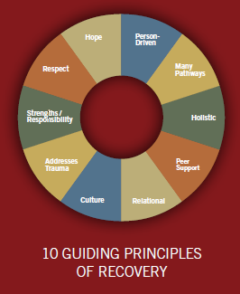
RECOVERY
Recovery emerges from hope
Recovery is person-driven
Recovery occurs via many pathways
Recovery is holistic
Recovery is supported by peers and allies
Recovery is supported through relationship and social networks
Recovery is culturally-based and influenced
Recovery is supported by addressing trauma
Recovery involves individual, family, and community strengths and responsibility
Recovery is based on respect
http://store.samhsa.gov/shin/content//PEP12-RECDEF/PEP12-RECDEF.pdf

Slide 4
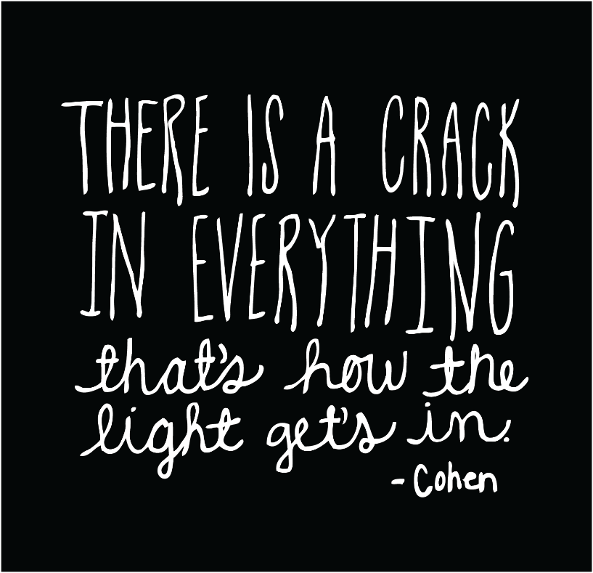

Slide 5
Outline of Our Time Together
Welcome, Agreements, and Definitions
Centering Wisdom from BIPOC voices
(BIPOC=Black, Indigenous, People of Color)
Overview of this Recovery Model/12 Steps

Slide 6
Being in this Space Together
Agreements, from Vanessa Jackson, LCSW
  Speak your truth…but hold my heart while you do it.
  Accept that the feelings and issues raised will need to be continued.
  We all share responsibility for creating safe enough spaces.
  Respect that we are at different levels of development on these issues. We need to be creative and patient in holding our container to include a variety of experiences.
Agreements for Courageous Conversations, Glenn Singleton
Stay engaged.
Experience discomfort.
Speak your truth.
Expect and accept non-closure.

Slide 7
What comes to mind…
…when you hear the term “White Supremacy”?

Slide 8
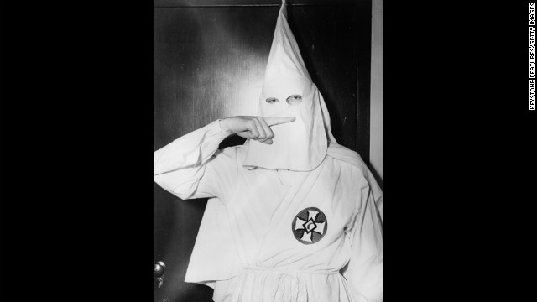
The face of White Supremacy

Slide 9

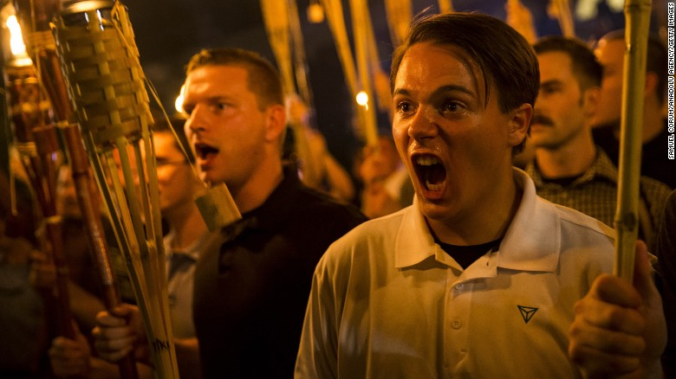
The face of White Supremacy

Slide 10

The face of White Supremacy
Notes:
Why would I add my picture here? (Group input)

Slide 11
Definition of White Supremacy
an historically based, institutionally perpetuated system of exploitation and oppression of continents, nations, and peoples of color by white peoples and nations of the European continent, for the purpose of maintaining and defending a system of wealth, power, and privilege.
a system, a web of interlocking, reinforcing institutions: economic, military, legal, educational, religious, and cultural. As a system, white supremacy affects every aspect of life in a country.
http://soaw.org/index.php?option=com_content&view=article&id=482

Slide 12
Definition of White Supremacy
White supremacy is ever present in our institutional and cultural assumptions that assign value, morality, goodness, and humanity to the white group while casting people and communities of color as worth less, immoral, bad, inhuman and "undeserving.“
http://www.dismantlingracism.org/racism-defined.html
White Supremacy: Centering of Whiteness as
NORMAL, RIGHT, and GOOD

Slide 13
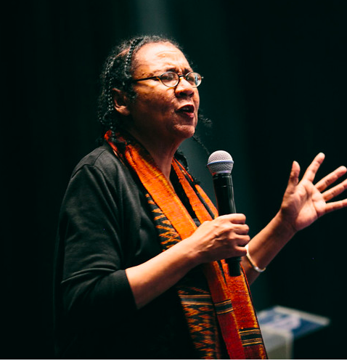
bell hooks: “imperialist white supremacist capitalist patriarchy” the power structure underlying the social order
Notes:
Intersectionality=essential…yet sometimes necessary to focus singularly on race→what we’ll be doing today

Slide 14
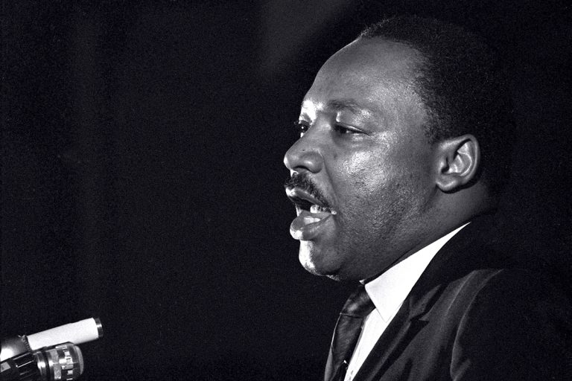
“The nation is sick. Trouble is in the land. Confusion all around.” –Dr. MLK Jr.
Notes:
Soul sickness

Slide 15
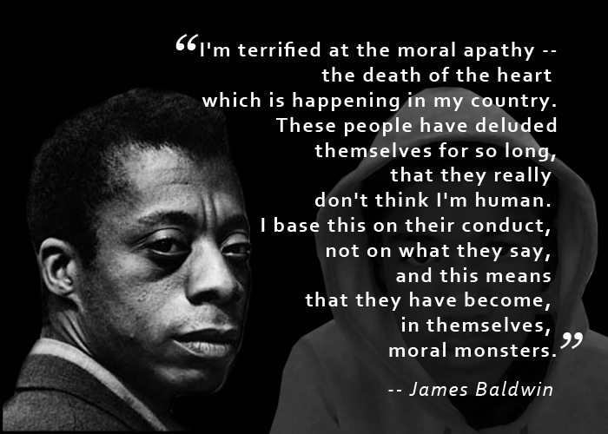

Slide 16
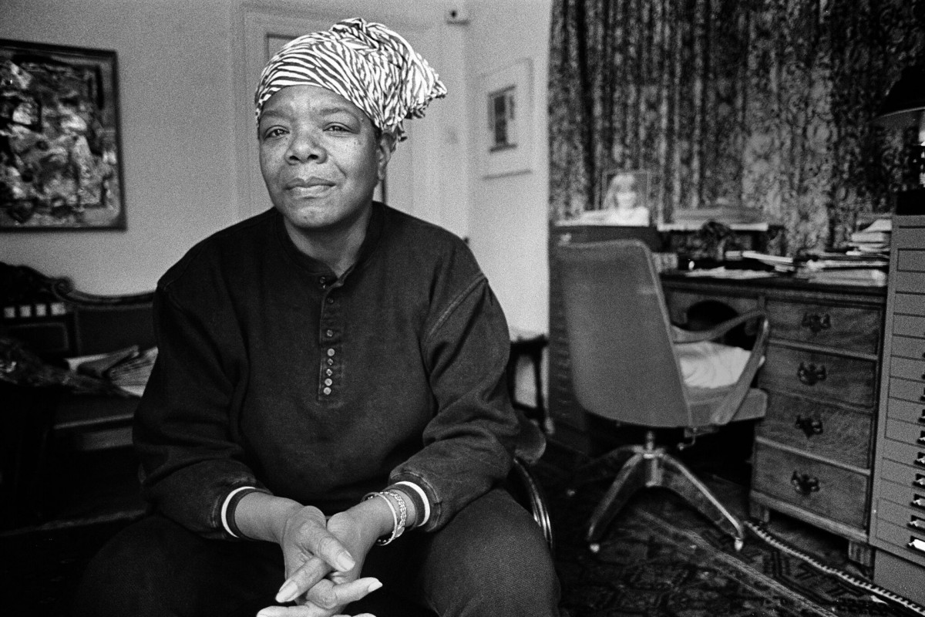
“The plague of racism is insidious, entering into minds as smoothly and quietly and invisibly as floating airborne microbes enter into bodies to find lifelong purchase in bloodstreams.”

Slide 17
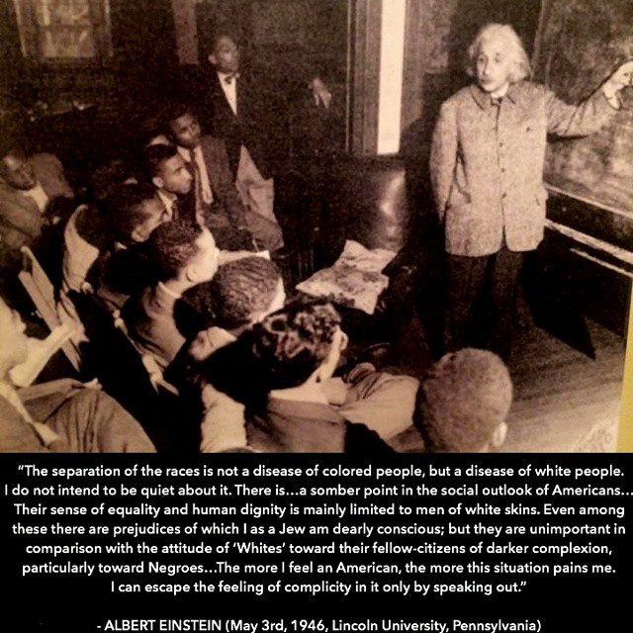

Slide 18

Dr. Alvin Poussaint, Psychiatry Professor
After several racist killings in the civil rights era, a group of black psychiatrists sought to have extreme bigotry classified as a mental disorder. The association's officials rejected the recommendation, arguing that because so many Americans are racist, even extreme racism in this country is normative—a cultural problem rather than an indication of psychopathology.

Slide 19
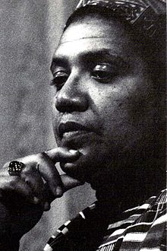
Audre Lorde
“When people of colour are expected to educate white people as to their humanity… the oppressors maintain their position and evade their responsibility for their own actions.”

Slide 20
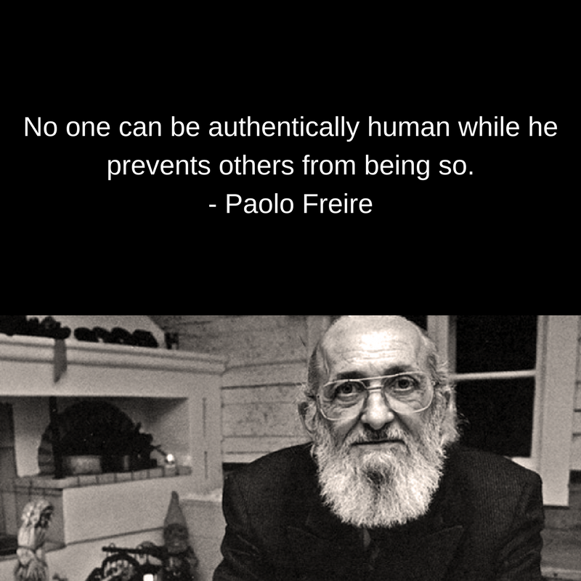

Slide 21
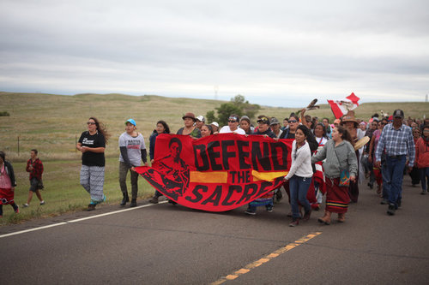
Prayer for the white man:
“And now, Grandfather,
I ask you to bless the white man.
He needs your wisdom, your guidance.
You see, for so long he has tried to destroy my people, and only feels comfortable when given power.
Bless them, show them the peace we understand; teach them humility.
For I fear they will someday destroy themselves and their children, as they have done so Mother Earth.
I plead, I cry, after all, they are my brothers…”
-Native American Indian

Slide 22
Origins of this 12 Step Model
BA and MSW Education: limitations in learning/training; in-home family therapy→dreams of an alternate universe
Ta-Nehisi Coates: https://www.youtube.com/watch?v=Pm9DJuTrO8Q
2015, 2016, 2017: MN’s Racial Disparities: http://247wallst.com/special-report/2015/12/07/worst-states-for-black-americans-2/4/
Blessings from mentors + SPARC grant, IASWG
Notes:
13:38 start time for T. Coates comments

Slide 23
The 12 Steps
A derivative work of Alcoholics Anonymous’ 12 Step Model

Slide 24
Step 1
We admitted that we had been socially conditioned by the ideology of white supremacy—that our minds were subject to racial biases, often unconsciously so.
The first step to any kind of recovery is admitting that we have a problem. Individuals not ready to acknowledge a problem may be unable to pursue and receive the help they need. Becoming aware of a problem—and admitting it to others—can be challenging, but it is a fundamental step on the recovery journey.

Slide 25
Step 1
https://www.youtube.com/watch?v=Rfpo-gUDSuE

Slide 26
Step 2
We came to believe that we could embrace our ignorance as an invitation to learn.
We acknowledge that we, as white people, will never know what it feels like to walk in the world as a person of color. We embrace our “not knowing” as a powerful reminder of our ongoing need for new learning, and we abandon white supremacist traditions of “knowing” how others should feel, think, and act.

Slide 27


Slide 28
Step 3
We developed support systems to keep us engaged in this work.
We are aware that facing and recovering from the effects of white conditioning will involve difficult, sometimes painful, moments. We commit to developing practices that facilitate self-care…to ensure that we are gentle with ourselves while also bravely able to confront the dehumanizing ideology of white supremacy.

Slide 29
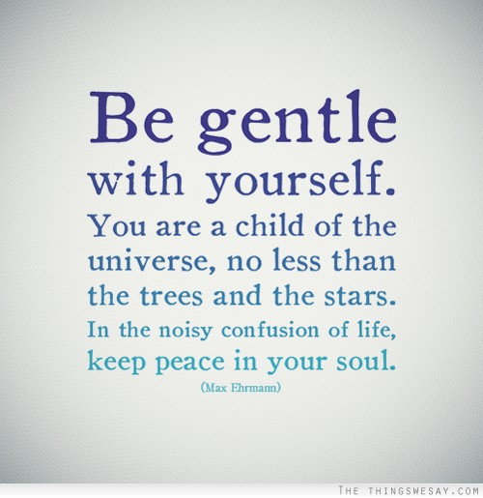

Slide 30
Step 4
We journeyed boldly inward, exploring and acknowledging ways in which white supremacist teachings have been integrated into our minds and spirits.
After acknowledging the problem, we must also acknowledge that it has impacted many areas of our lives, consciously and unconsciously. Each of us must explore ways, past and present, in which the ideology of white supremacy has negatively impacted us: our understanding of history, our social networks, and our patterns of interacting with people of color, with an emphasized focus on microaggressions.

Slide 31
Microaggressions
Wing Sue and his colleagues identify three types:
1. A microinsult is characterized by communications that convey rudeness and insensitivity and demean a person’s racial heritage or identity (for example, eye rolling during a discussion about an individual’s racial identity).
2. Microinvalidations are communications that exclude, negate or nullify the psychological thoughts, feelings, or experiential reality of a person of color. An example is a white person stating to a person of color that they “don’t see color”, which denies that person’s racial and ethnic experiences.
3. A microassault is an explicit racial derogation characterized primarily by a verbal or nonverbal attack meant to hurt the intended victim. This can happen through name-calling, avoidant behavior, or purposeful discriminatory actions. Microassaults are typically more conscious and deliberate than other forms of microaggression.
http://www.extension.umn.edu/family/cyfc/our-programs/ereview/docs/cmhereviewOct10.pdf

Slide 32
Step 5
We confessed our mistakes to ourselves and others.
Beyond identifying ways in which our thinking, feeling, and relating have been impacted by white conditioning, honestly addressing the actions that have emerged from that conditioning is a separate, necessary step. Confessing past (and ongoing) microaggressions to a group and receiving support is an essential part of recovery.

Slide 33
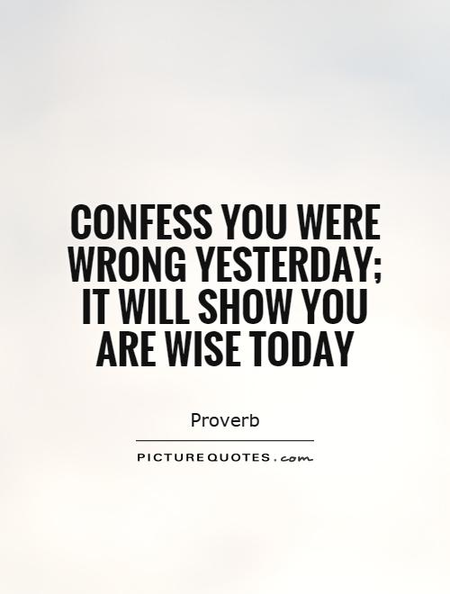

Slide 34
Step 6
We were entirely ready to deconstruct previous ways of knowing, as they had been developed through the lens of white supremacy.
After admitting these problems (white conditioning and related actions), it is then time to let go of “knowledge” developed in isolation from people of color.

Slide 35
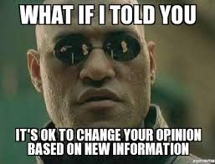

Slide 36
Step 7
We humbly explored new ways of understanding…proactively seeking out new learning and reconstructing a more inclusive sense of reality.
This step involves mindfully and intentionally engaging in learning to more deeply understand the experience of people of color in a society organized around white supremacy. This type of learning can take place in a variety of ways, including: reading texts written by people of color, actively listening to the experiences of people of color, patronizing businesses owned by people of color, etc.

Slide 37
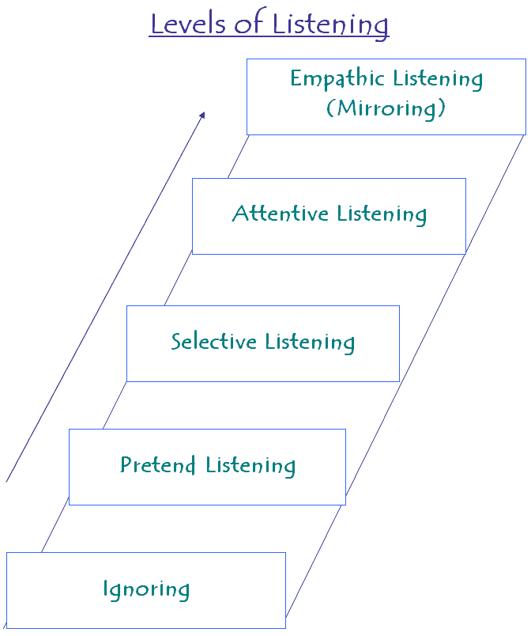
Reconstructing a more inclusive sense of reality
http://www.hmongchamber.com/
http://www.blacktwincities.com/black-business-directory/
http://www.ledc-mn.org/
http://aeds-mn.org/category/little-africa-of-minnesota
http://www.maicnet.org/
Recommended Authors (endless options)
  Ta-Nehisi Coates
  Audre Lorde
  Gish Jen
  Chimamanda Adichie
  Gloria Anzaldua

Slide 38
Step 8
We committed ourselves to ongoing study of our racial biases, conscious or unconscious, and our maladaptive patterns of white supremacist thinking.
This step is about identifying our triggers to negative thoughts (or other stereotypes, positive or negative) about people of color. We remain curious about the source of our thoughts, fears, and assumptions…and perpetually aware of their existence.

Slide 39
 | Situation or Trigger | Automatic Negative Thought | Distress (0-100%)
Monday
Tuesday
Wednesday
Thursday
Friday
Saturday
Sunday

Slide 40
Step 9
We developed strategies to counteract our racial biases.
Developing positive associations to counter negative thoughts is an important, proactive strategy in recovery from white supremacy. We believe that the most powerful way to develop positive associations is to develop authentic relationships with people of color. In lieu of such relationships, we can still engage in daily, proactive practices to retrain our brain from the ill-effects of white supremacist conditioning.

Slide 41
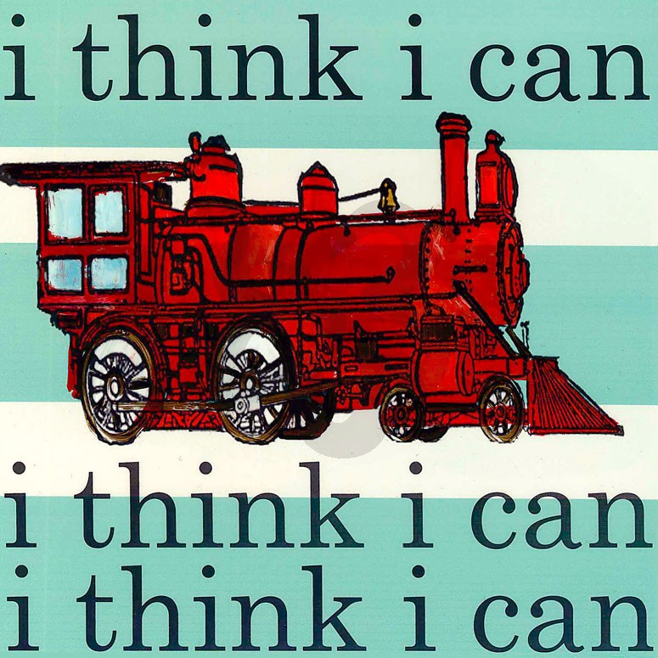

Slide 42
Step 10
We embraced the responsibility of focusing on our impact, more than our intentions, in interactions with people of color.
Taking responsibility for the impact of our actions is an ongoing part of recovery. If we fall back into perpetuating white supremacist ideology—or defending actions that have caused hurt to people of color—it's important to stop and admit it. Prioritizing impact, instead of explaining the intent of our behavior (i.e. “I didn’t mean to offend you”), is essential for attending to the human being in front of us.

Slide 43
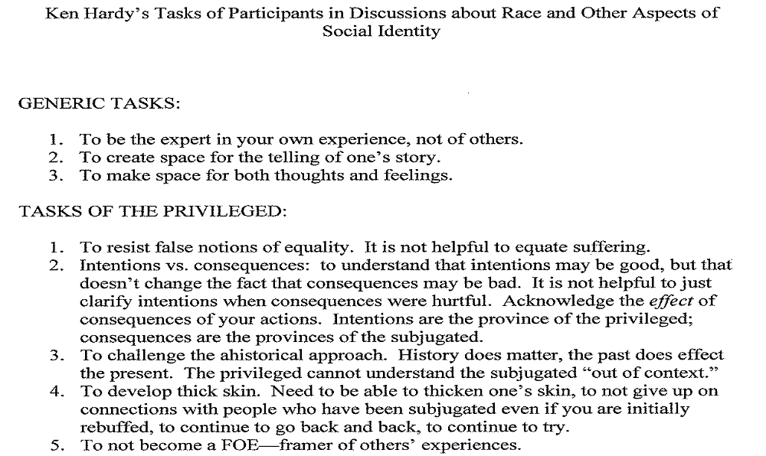
Intentions: Province of the Privileged

Slide 44
Step 11
We engaged in daily practices of self-reflection.
Reflecting on the day—on moments in which we confronted our own white supremacist conditioning and on moments in which we were still bound by its limiting beliefs—is an investment in our recovery. Relevant spiritual practices may play a helpful role in this step, as a way to encourage us toward continued growth and connection, beyond our mistakes.

Slide 45


Slide 46
Step 12
We committed ourselves to sharing this message with our white brothers, sisters, and siblings…in order to build a supportive recovery community and to encourage personal accountability within our culture.
Assisting others to seek help in recovering from white conditioning and in becoming an ally with people of color is a core component of recovery. Working with future recovery-from-white-conditioning groups is a common choice for this step.

Slide 47
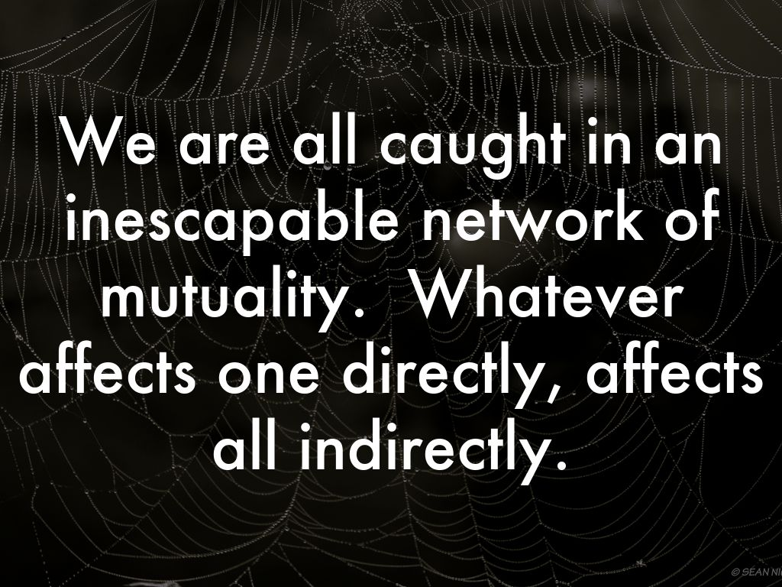

Slide 48
Meeting Structure/Rituals
Call to Recovery: “We are here to be fully human to ourselves, fully accountable to each other.” (credit: Shailja Patel, author of Migritude)
Welcome & Introductions
Announcements, calendar, etc.
Minute of silence; quick reading about a white anti-racist
Read aloud the 12 steps.
Focus of today: Step __→Reading + uninterrupted time to speak (or pass)
Closing and repeating of Call to Recovery
Post-meeting Dialogue (back and forth!)

Slide 49
Call to Recovery
“We are here to be fully human to ourselves… fully accountable to each other.”
-Shailja Patel, cr. author of Migritude

Slide 50
Next Steps
Your presence here today→You=Trusted Servant
Freedom to apply these concepts in your life/work/community
Current website: recoveryfromwhiteconditioning.com
  All materials downloadable for free: use on your own or start your own recovery group.
Contact Info, if you have follow-up questions: cristinacombs@gmail.com
Weekly Group: Wednesdays from 6-7 pm on Zoom

